Slide 1
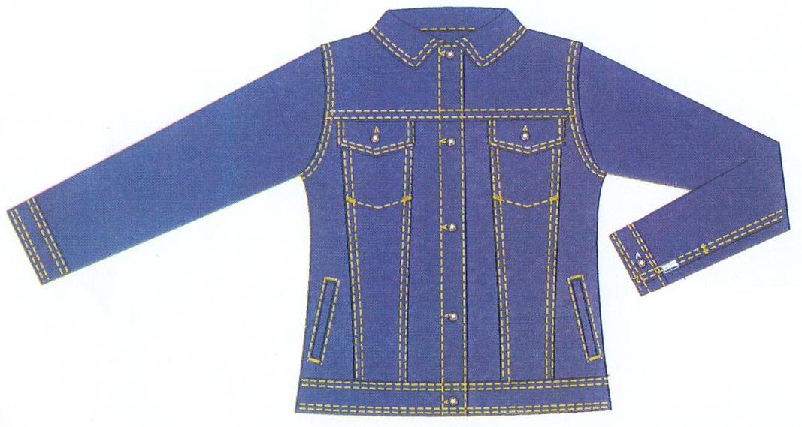
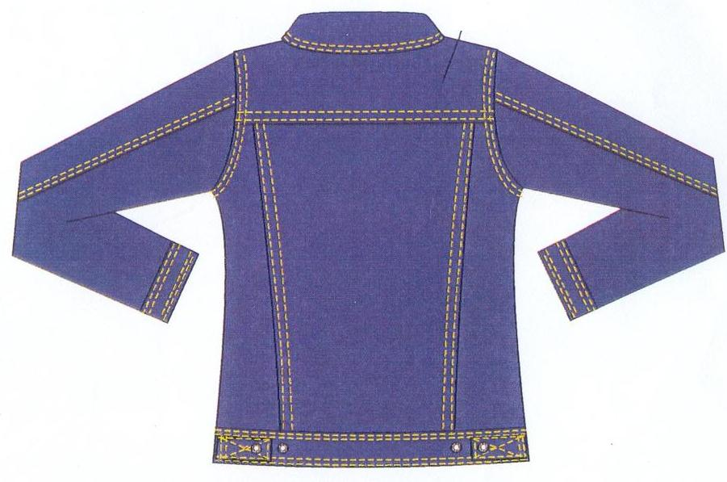
FRONT
BACK

Slide 2
Operation breakdown of a jacket
Components of a jacket
Top Front 2
Side bottom front 2
Mid bottom front 2
CF bottom front 2
Back 3
Yoke 2
Pocket 2
Pocket flaps 4
Collar 2
Front Sleeve 2
Back sleeve 4
Cuffs 4
Under band 1
Front placket

Slide 3
1. Preparing the front
Tack pocket bag at the top of the mid panel from the wrong side
Attach mid, side and CF panel together while attaching pocket to the panel seam
Top stitch the panel seam
2. Preparing the Flaps
Attach interlining to the top flap
Join top and bottom flaps
Trim and turn
Top stitch flaps

Slide 4
4. Preparing the Back
Attach mid, and two side panels together
Top stitch panel seams
Attach yoke to the back
Top stitch the yoke seam
5. Preparing the collar
Attaching the top and under collars
Bag out & top stitch the collar

Slide 5
6.Prepairing cuffs
Hem top cuff
Attaching top and bottom cuffs
Bag out & top stitch
7. Sleeve
Join two sleeve pieces together leaving space for the sleeve open
Top stitch sleeve seam
8. Under Band
Join two under bands together
Trim and turn
Top stitch top side of the band

Slide 6
ASSEMBLY
Attach two yoke panels to the back panel
Top stitch on the Yoke
Sew shoulder seam while inserting pocket flaps
Top stitch the shoulder seam
Attach sleeve to the armhole
Top stitch around the armhole
Sew side seam and underarm seam
Attach under band
Attach front placket
Attach collar to the neck line
Close collar seam
Sew buttons and button holes

Slide 7
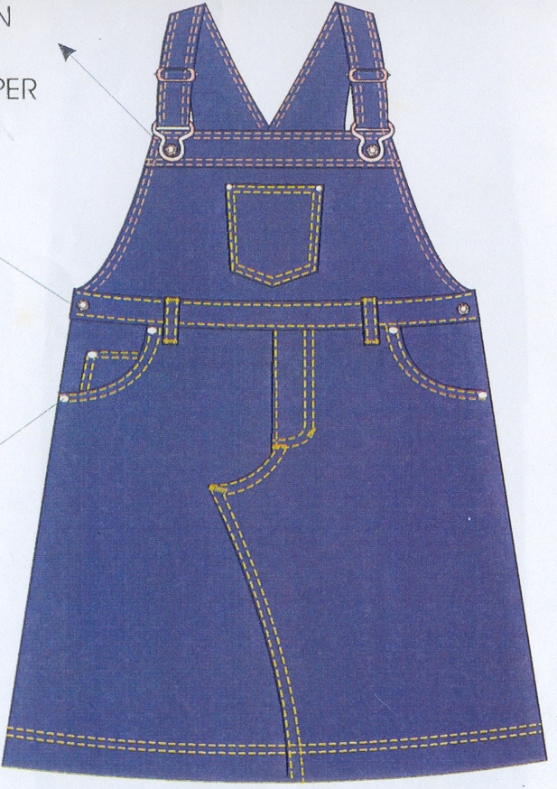
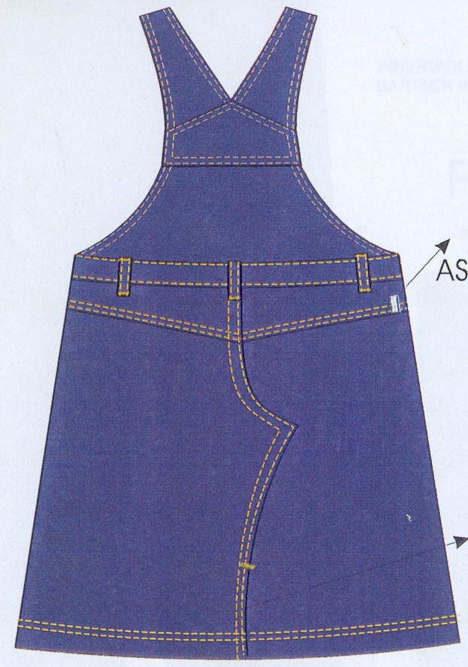
BACK
FRONT

Slide 8
Operations sam operators machines

